Slide 1

Ministry/ organization name: - state Government/ government of goa problem statement: - alumni tracking system team name: - Shadow crew team leader name: - rishav Thakur college code: -
Idea/ Solution / Prototype
In current scenario, Universities and colleges are increasing day by day and currently, there is no mechanism for colleges and directorate to keep track of the students that are passing out every year.
the existing system is a manual one in which institutes maintain offline records either on paper or using software like Ms. Excel.
This system raises the issue of time management. It is difficult to manage historical data which needs much space to keep all the records of alumni.
This alumni tracking system is a web application which is under the information systems. It helps an institution to track its alumni. Also, it helps the alumni to communicate with the institution through the use of the internet. It also helps the alumni to get update with the latest news and upcoming events of the institution.
This application can easily be accessed through the use of the internet which will be very useful to alumni because they can keep in touch with the institution even if they do not visit the institute.
Alumni systems are web-based information systems which are created by the universities to maintain relations with its students after they graduate. Universities use the systems to collect alumni information and organize outreach activities. This system collects information about the current location, workplace and job information.

Slide 2
SOLUTION:
The design and implementation of the ALUMNI Dashboard system will be available for general public use through the web interface. The non-registered visitors can register themselves, if they are graduated from that institute. New user detail will be verified with Database. Registered Alumni can look at the list of graduates, according to the year of graduation or a field of study. He can also look at graduates profiles. The data of profile details shown to the other user will be limited. The graduates can also add some information about themselves into the system such as working experience, knowledge, etc. All the information related to the graduates can only be accessed by the Institute. There will be two admins, one will be the University admin, who can access and manage all the details regarding associated Colleges and their graduates. Second will be College admin who can access and manage all the details of their alumni. This system allow the colleges to search details based on criteria such as year, subject, etc. Also allow the Directorate to search details based on criteria such as colleges, year, subject, etc. Institute can send messages and e-mails to alumni members. System will also have features like group chats, information about events, publish notices on the portal and login for every user.
PROTOTYPE:
The Front End will be highly dynamic and will be developed keeping in mind the minimalistic UI/UX design principles, for easy and interactive use of the application. The project is to create a system for managing Student alumni data. The software components will be a database and an alumni website. The website will include various web applications that will be used by alumni and Institute admin to manage the data. The software must be extensible as the requirements are likely to change over time. The project is envisaged to be completed in two phases. The initial phase will be the creation of a simple system that will be used to capture data from current final year students before the end of term. The second phase of development will extend the functionality of the system to allow past alumni to register. The Alumni will responsible for entering the details, entered detail will be cross examined. Only after registration approval, Alumni login credential will validate. After verification Alumni can manage their profile. Institute admin can communicate with registered user through the portal.
TECHNOLOGY STACK:
FRONT-END Technology Stack
HTML
CSS
JavaScript
BACK-END Technology Stack
MySQL
phpMyAdmin
PHP

Slide 3
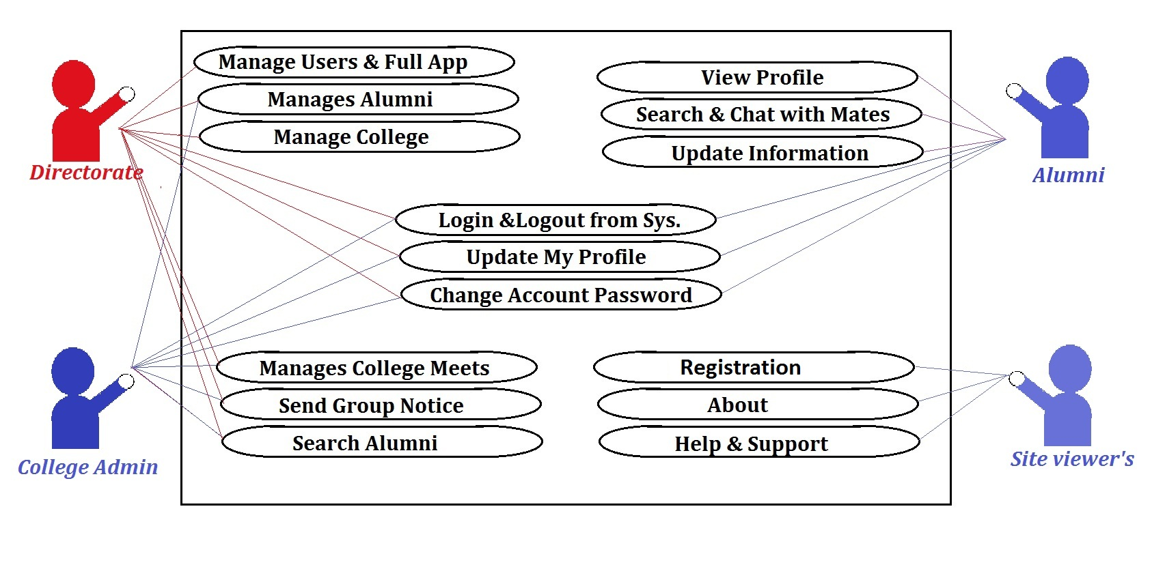
USE CASE DIAGRAM

Slide 4
DEPENDENCIES
Our project solution is very much reliant on the Alumni interest. The Alumni should have enthusiasm and willingness to register themselves on the System.
The system will effective only when Users will be active. Alumni should check their account frequently. Also they have to update their status over time.
This Tracking system will be beneficial, if Alumni update their right profile, workplace, job information and location.
SHOW STOPPER
AWARENESS: - If graduates will not aware about this system then this will be a problem for system functioning. This is Institute responsibility to aware their Alumni.
RECORDS: - If an institute doesn’t have a proper record of their graduate students then this system will not work in a successive way.

